Slide 1
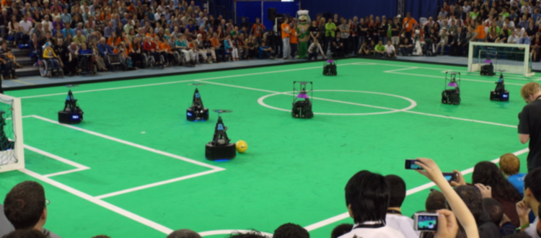
Stakeholder meeting- AutoRef
08/03/2024
Quinten Swaan, Project Manager
Department of Mathematics and Computer Science, EngD. Mechatronic Systems Design

Slide 2
Agenda
Goal: update on progress.
Planning
Risks
Validation
Sensor system
Ball out of Play
Last Touch
Summary
14:00 – 14:05
14:05 – 14:10
14:10 – 14:20
14:20 – 14:30
14:30 – 14:40
14:45 – 14:58
14:58 – 15:00

Slide 3
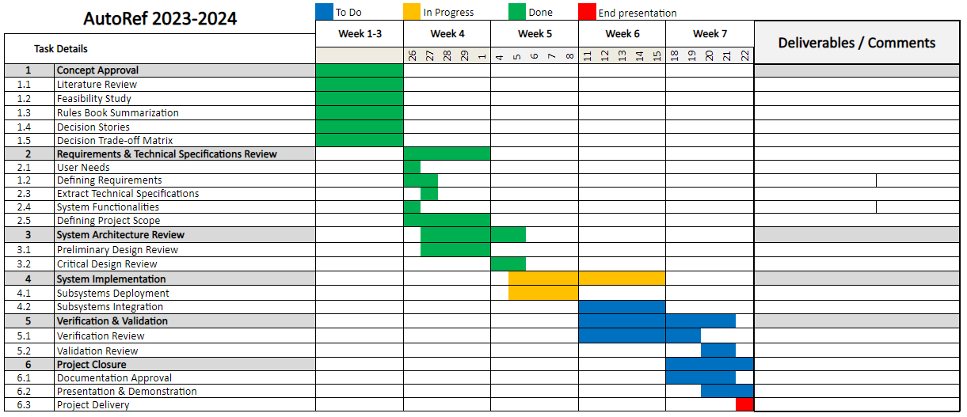
Planning

Slide 4
Risks
Legend
Low
Edge cases
Medium
Occurrence
Integration
Sensing accuracy
High
Validation and verification
Trust
Bias
Severity

Slide 5
Validation objectives
Validating the functional requirements
Real-world scenarios
Comparison to human referees
Ground truth
Statistical Analysis

Slide 6
Setup
Initial Preparations
System Setup
Independence Verification
Real-world Scenario
2 vs. 2 match at Tech United field
Human referees assisted by the Autoref system
Edge cases
Input Data Validation
Recording and ground truth analysis

Slide 7
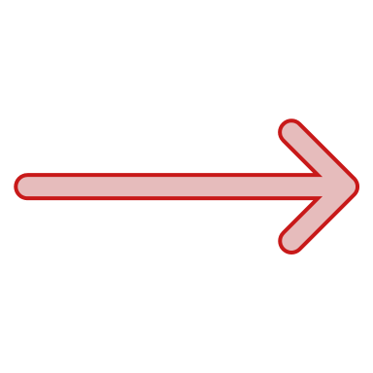
Analysis Methods overview
Statistical Metrics
Accuracy
Confusion Matrix
F1 Score
Comparison to Human Referee
Human-like Decision Making
Overall Performance

Slide 8
Decision For Sensor Type
 | Adequate (50%) | Producibility (25%) | Transparency (15%) | Simplicity (10%) | Score
Vision-based | 5 | 4 | 2 | 2 | 4
Sound-based | 0 | 1 | 3 | 2 | 0.9
Thermal-based | 0 | 1 | 3 | 1 | 0.8
Force-based | 0 | 3 | 4 | 3 | 1.65
Radio waves-based | 5 | 1 | 5 | 2 | 3.7
Min: 0 Max: 5
Notes:
Adequate: Is it enough to just use only that sensor?
Producibility: Can MSD make it before the deadline?
Transparency: Will there be interference when it’s being used?
Simplicity: How much computational power is necessary?

Slide 9
Decision For Vision-Based Sensor Type
 | Accuracy (50%) | Producibility (25%) | Robustness (15%) | Affordable (10%) | Score
CCTV Cameras | 2 | 4 | 3 | 5 | 2.95
OptiTrack | 5 | 5 | 4 | 2 | 4.55
Vicon | 5 | 2 | 4 | 2 | 3.8
ToF Cameras | 4 | 2 | 3 | 3 | 3.25
Stereo Cameras | 3 | 3 | 2 | 4 | 2.95
Min: 0 Max: 5
Notes:
Producibility: Can MSD make it before the deadline?
Robustness: Will it work if there are some interferences?
Affordable: Is it low-cost?

Slide 10
Ball out of Play
Summing uncertainties for requirement ±15 mm accuracy
Assume Gaussian distribution
Uncertainty source | Uncertainty [mm]
OptiTrack measurements | ± 2
OptiTrack FPS limitation | ± 22.22
Field calibration | ± 2
Ball uncertainty | ± 6.3
Total | ± 23.27

Slide 11
Ball out of Play
Summing uncertainties for requirement ±15 mm accuracy
Assume Gaussian distribution
Uncertainty source | Uncertainty [mm]
OptiTrack measurements | ± 2
OptiTrack FPS limitation with estimation | ± 11.11
Field calibration | ± 2
Ball uncertainty | ± 6.3
Total | ± 13.08

Slide 12
Ball out of Play (BOOP) Progress
Defined the limits of the field – smoothened the data
Wrote the draft code for offline data, considering:
Measurement error – by using multiple data points to confirm out of play
Placement error – by interpolating between data points
Wrong decision – by waiting the command from refbox
Final output from the code will be the index of data point when BOOP and the corresponding time
Next step: Implementing the code to livestream data
Steps followed for BOOP

Slide 13
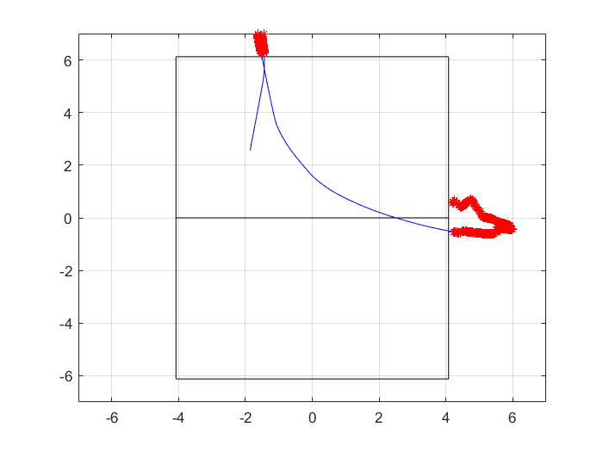
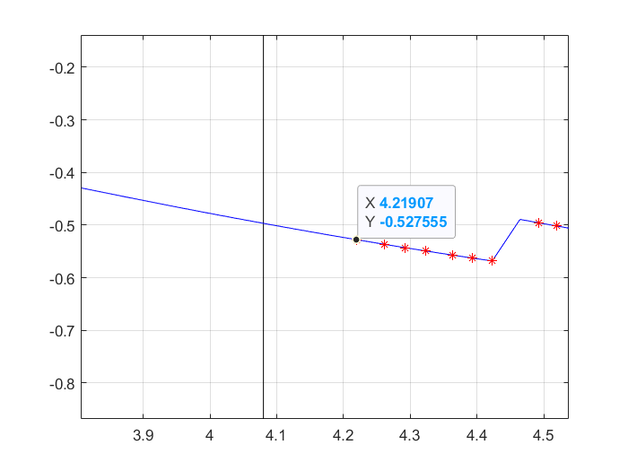
Initial Results
Output from the draft code with offline data

Slide 14
Possible Solutions for Last Touch Detection
Boundary Frames
Frames over objects (ball and players)
Trajectory Tracking
Physics Based Model
Kalman Filtering
Trajectory prediction using regression
Trajectory Extrapolation
Classification
Binary Classifier
Notes:
Deniz?

Slide 15
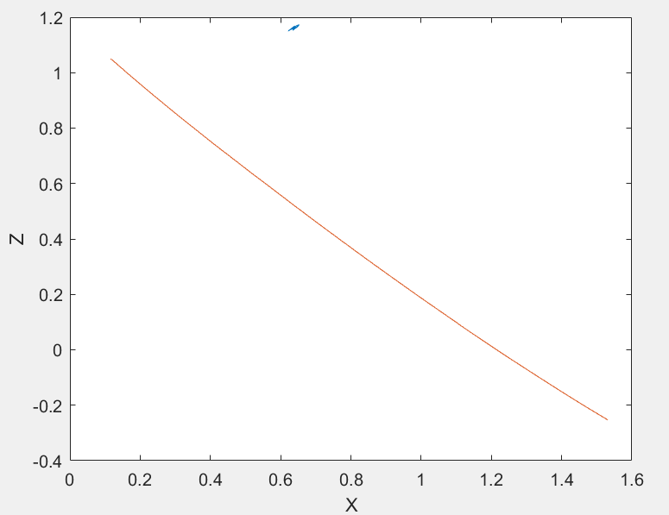
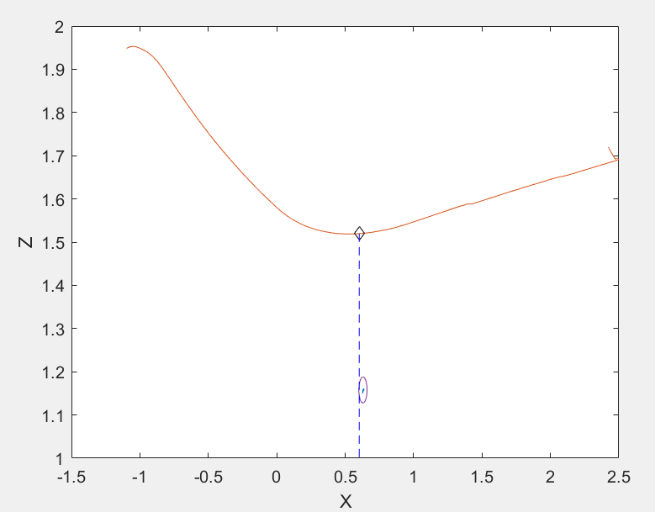
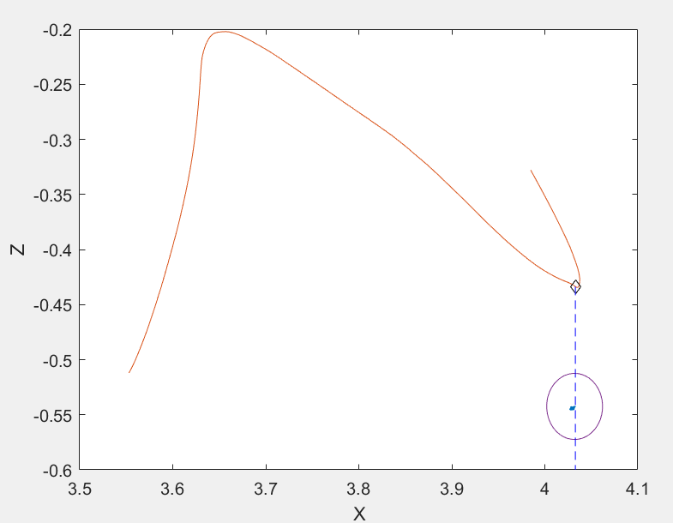
Possible Solutions for Last Touch Detection
No Touch
Touch
Touch
Notes:
Deniz?

Slide 16
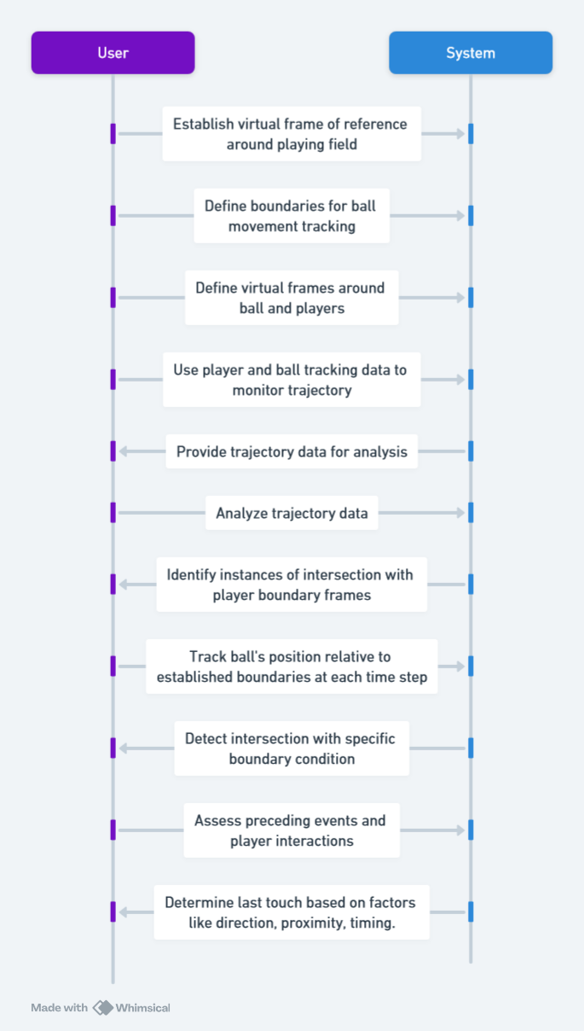
Possible Solutions for Last Touch Detection
Boundary Frames​
Notes:
Deniz?

Slide 17
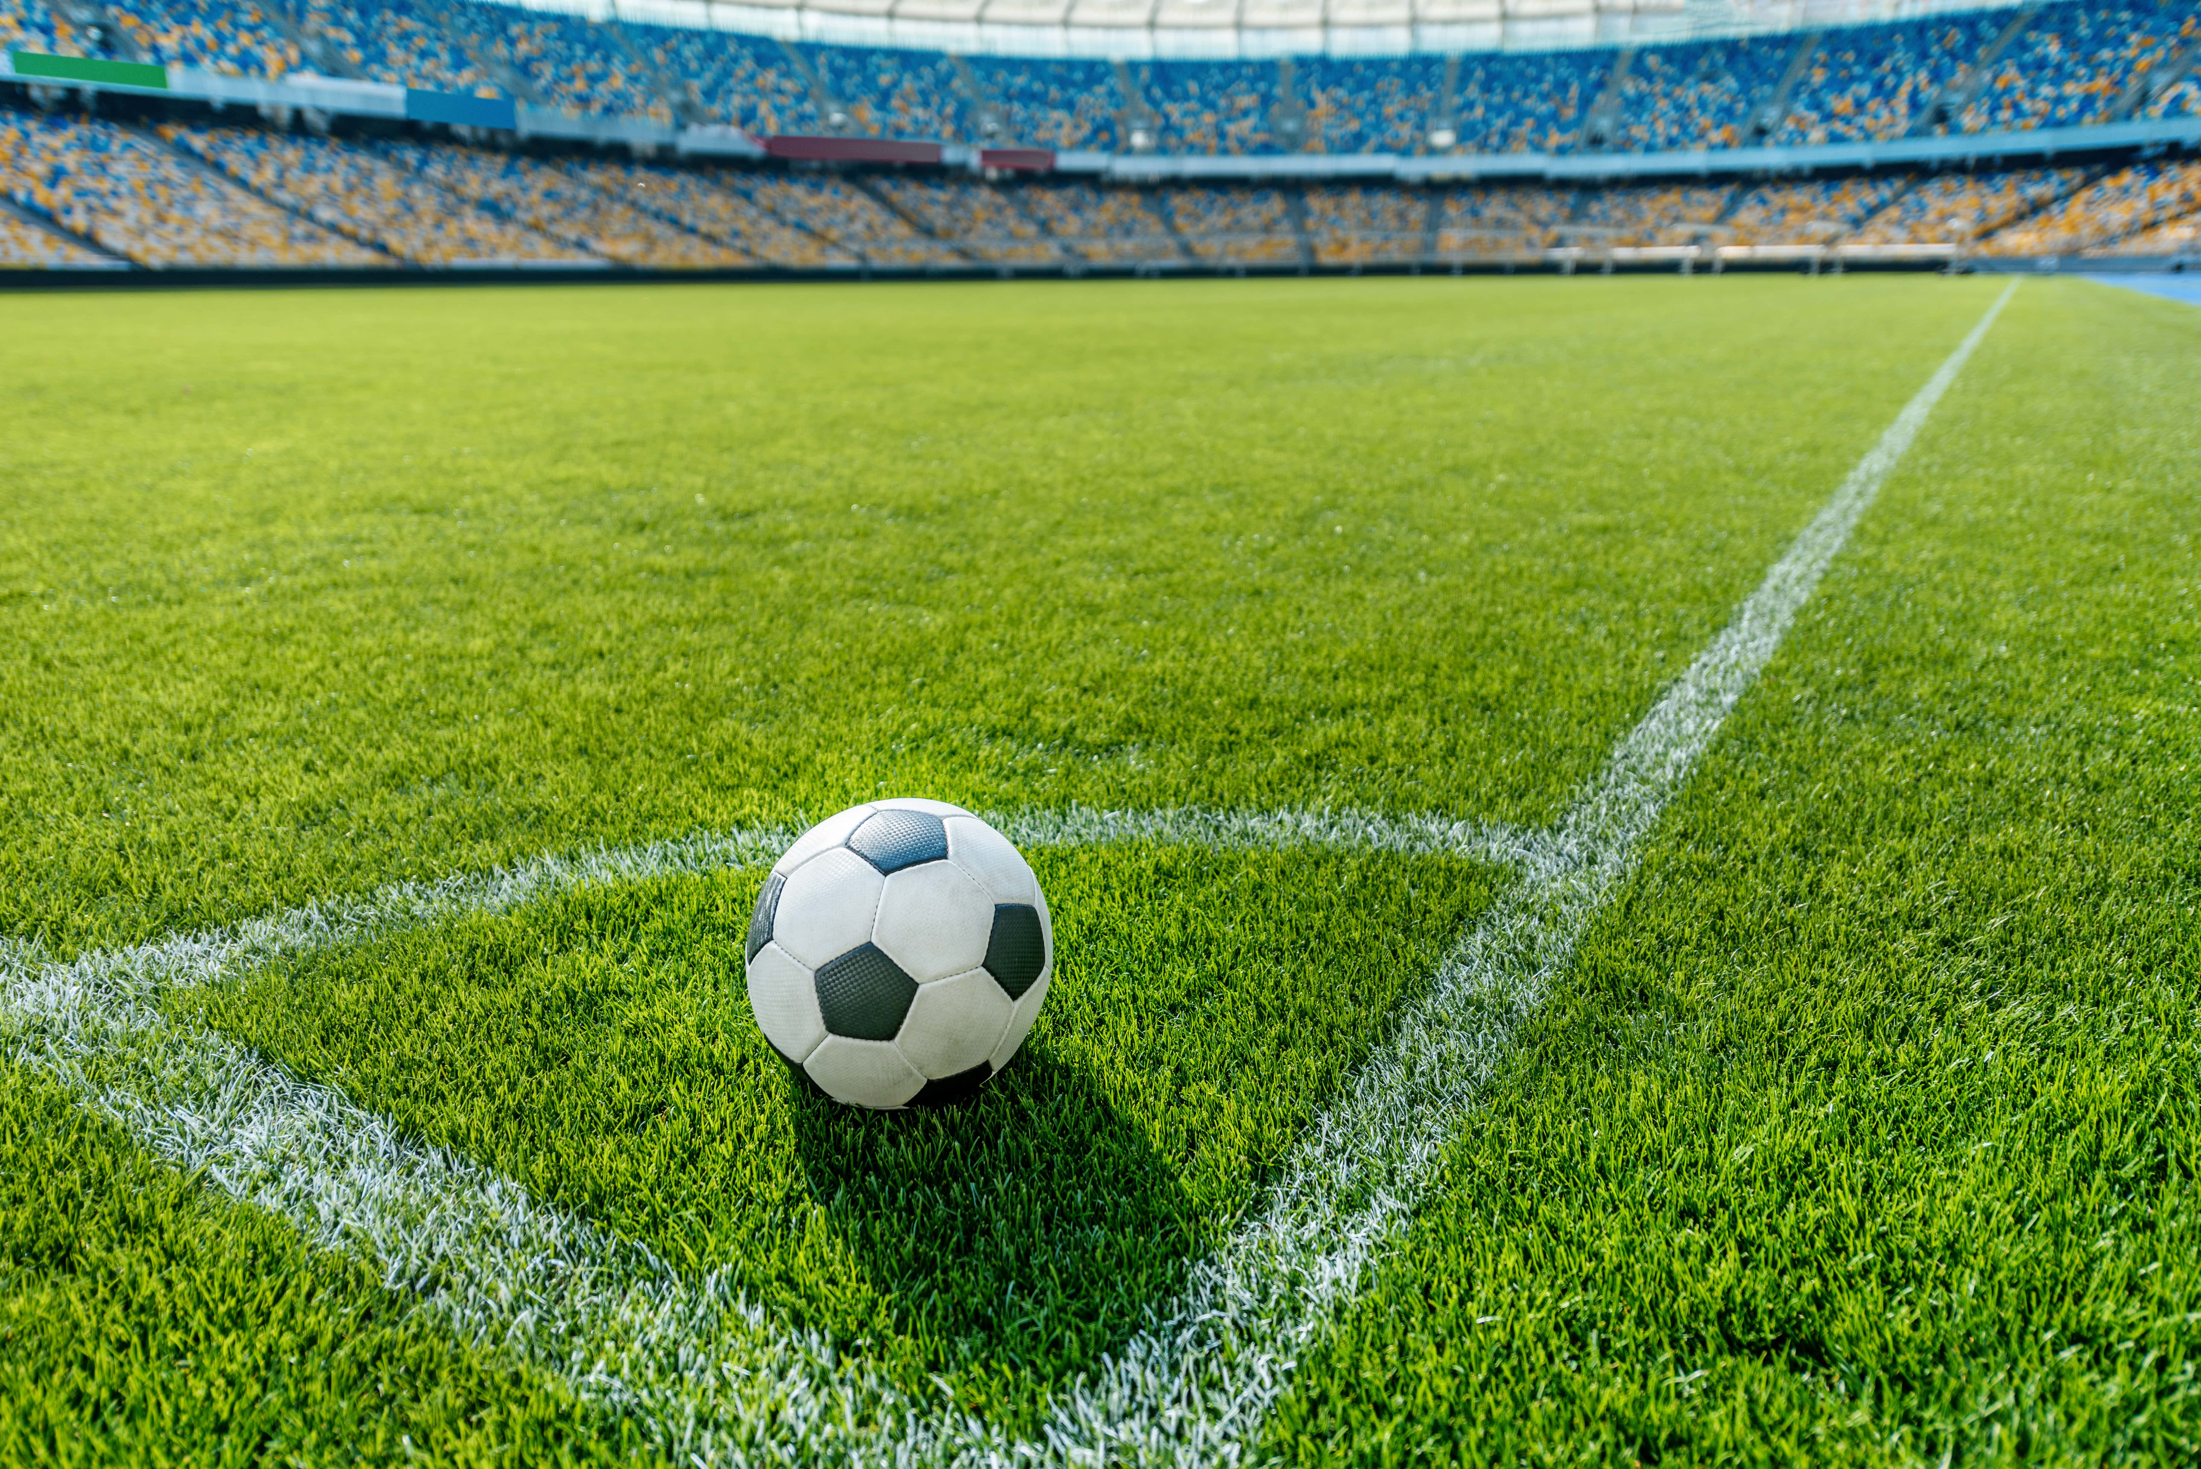
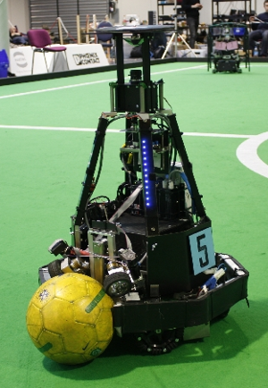
Possible Solutions for Last Touch Detection
Trajectory Prediction using Regression – Ball on Ground/ Clamped to Robot
First check whether the ball is on the ground or not.
Then check if the ball is clamped to a robot, if yes, to which one, by calculating the variance of the distances of points on each robot to the ball over time.
If the ball is clamped to a robot, then the ball last touched that robot.
Football On Ground. Source: https://blog.decathlon.in/articles/football-ground-measurements
Robot Clamping the Ball. Source: https://roboearth.ethz.ch/robocup-german-open-2010/index.html
Notes:
Deniz?

Slide 18
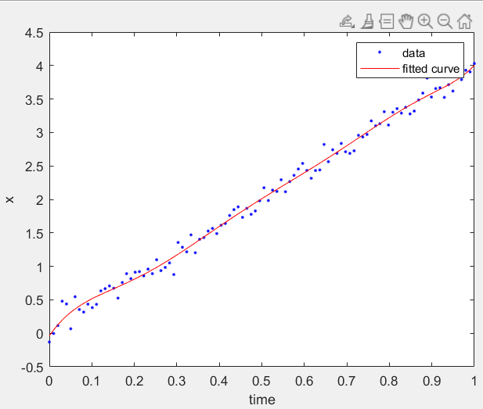
Possible Solutions for Last Touch Detection
Trajectory Prediction using Regression – Curve Fitting
If the ball is not clamped to any robot, then the its position can be predicted
by using curve fitting, which can then give us confidence bounds on
the future position of the ball.
If the future position doesn't fit the confidence bounds, we can predict that
a collision occurred.
Trajectory Prediction using Regression – Robot that Collided
Measure the distance from each robot to the ball, and the closest
one is responsible for collision, that is, unless the ball collided with
the goal post or went out of bound.
Notes:
Deniz?

Slide 19
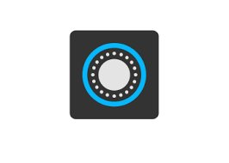
Possible Solutions for Last Touch Detection
Classification
Feature Extraction
Ball Pose
Robot Pose
Other Features
Label
Training Set
Validation Set
Test Set
Train a Binary Classifier
Logistic Regression
Multi-Layer Perceptron
Validate Model's performance
Accuracy
F1-Score
Area under ROC
Check the model's Generalization
Notes:
Deniz?

Slide 20
Possible Solutions for Last Touch Detection
Classification
On Real-Time
Get data per time step
Use defined Feature Extractor Function to extract the features of the ball and the robots
Per each robot check the distance between the ball and the robot
If it is less than some threshold
Predict touch/no-touch per each robot
If it is touch give the robot's ID
Notes:
Deniz?

Slide 21
Summary

